Slide 1
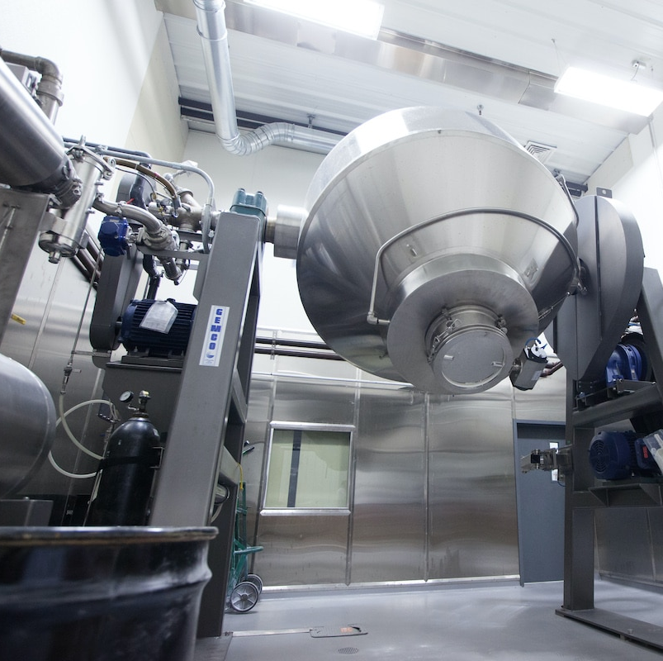
3D Printing Optimization
One random object you need in one snap.
Look up online and have that item ready in a few hours.
3D printing has been revolutionized in the past few decades.
3D printers almost capable of building anything.
Freedom to design, prototyping…

Slide 2
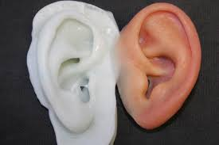
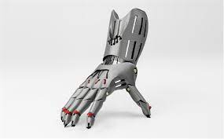
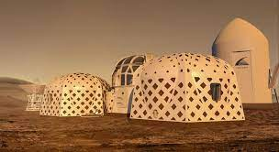
Opportunities
3D printing, also known as additive manufacturing, is an alternative production technology which allows for a layer-by-layer creation of more durable, stronger and lighter objects.
3D printers build:
prosthetic limbs
Shoes
Body parts
Liquid and materials can print conjointly a candy bar.
NASA is working to create theoretical shelters that would be 3D printed on Mars.

Slide 3
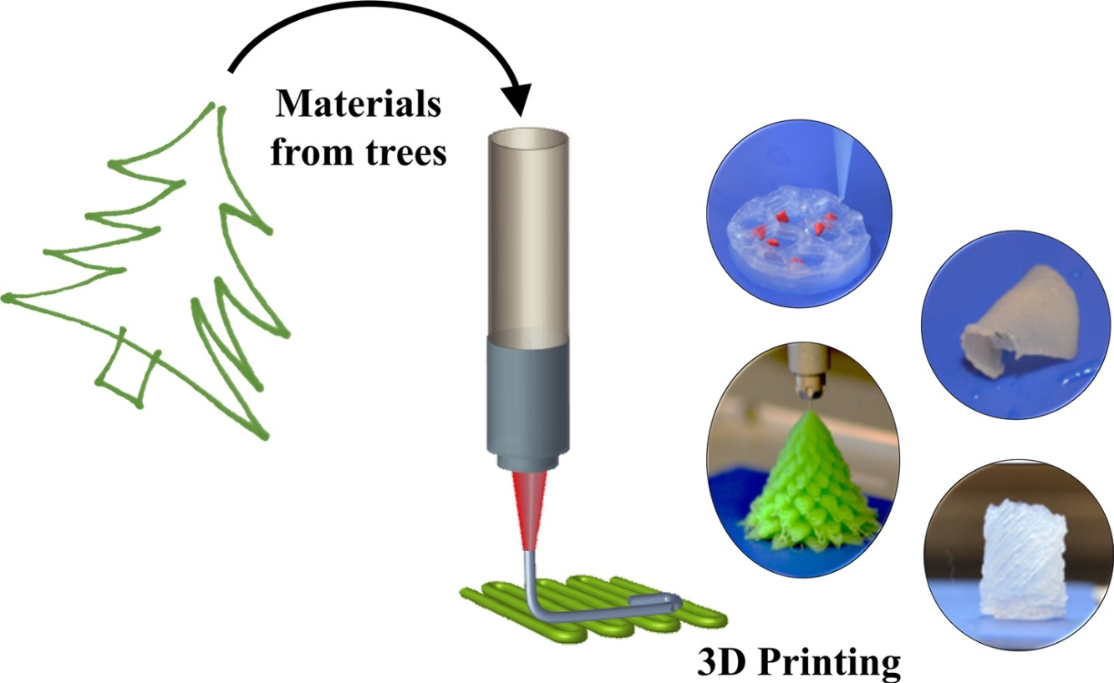
Where does 3D printing stand on the green scale?
It facilitates more efficient designs and creates less waste.
It allows engineers to explore new design practices, like topology optimization, with the opportunity to create more efficient, lightweight parts.
researchers used topology optimization to reduce the weight of a metal aircraft bracket.
3D printing requires energy to run which correlates with environmental considerations, like CO2 emissions

Slide 4
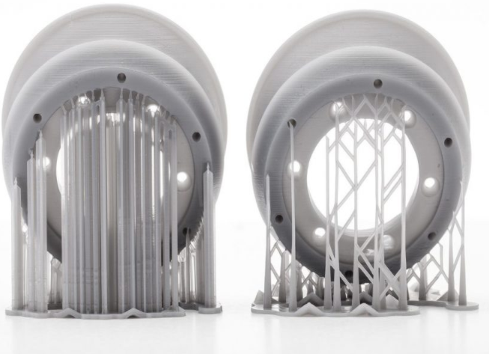
Stand on the green scale
when considering different factors, like material waste, the possibility of material recycling and post-processing, it’s been shown that machining is the most energy-consuming process, due to the amount of material waste.
Failed prints are large source of waste.
Optimization: accuracy and repeatability for precise parts

Slide 5

Conclusion
There’s no simple answer to the question of 3D printing’s sustainability. Some processes have the drawback of non-recyclable materials, while others are plagued by high energy consumption.
3D printing tends to be more resource-saving, particularly compared to subtractive technologies. And it also opens the door for more efficient designs that contribute to lowering manufacturing and inventory requirements and, ultimately, help to reduce fuel consumption. 3D printing is not entirely ‘green’ technology, but with the right approach, it can come closer to becoming an incredibly powerful sustainable manufacturing solution.

Slide 6
References
How Sustainable is Industrial 3D Printing? – AMFG
3D printing for everyone. | Renee Dobre | TEDxUOregon – YouTube

